Slide 1
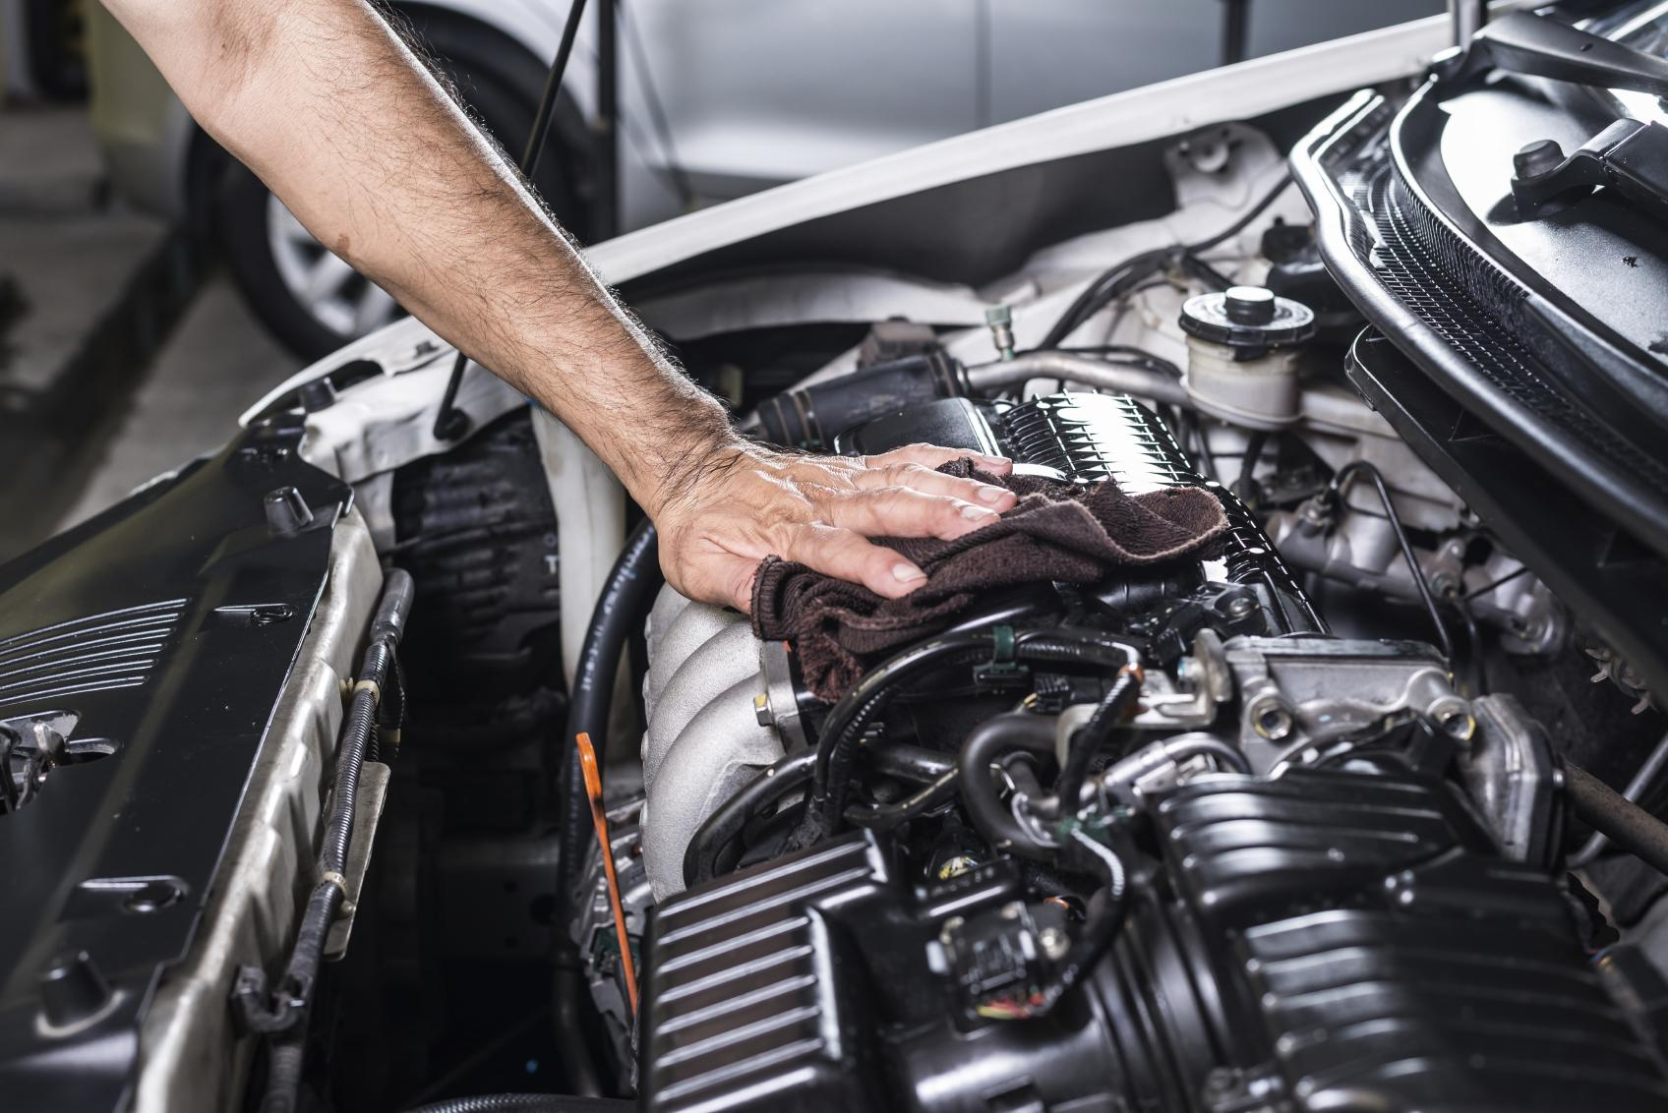

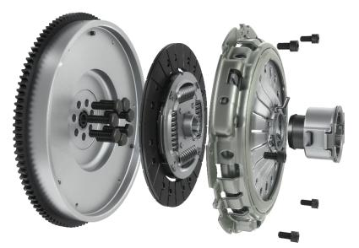
SMART
SOLUTIONS
CONVERSION
KIT4PTM
The smart and competitive all-in-one solution for your workshops

Slide 2
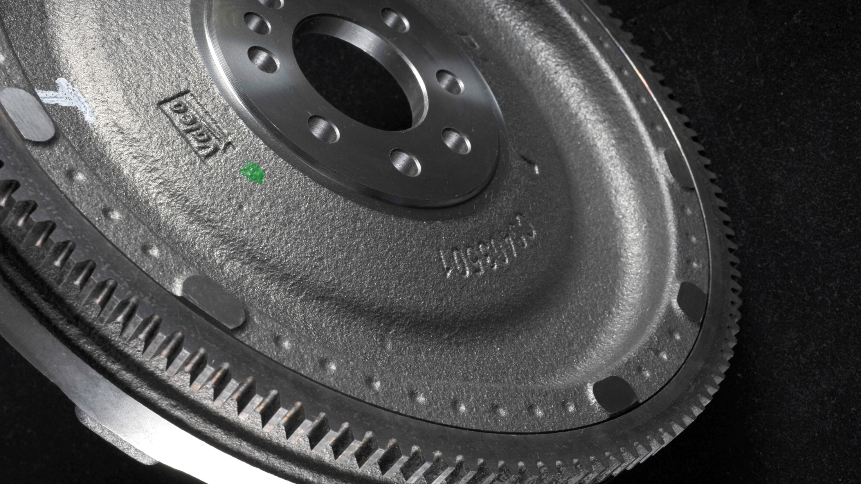
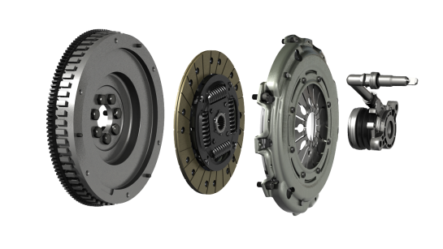
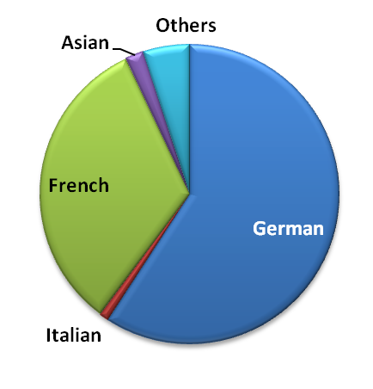
The ideal repair solution for Severe
Clutch Usage
KIT4PTM
65 P/N
Conversion KIT4P with Hydraulic bearing
+17 P/N
by Q1 2019
55 P/N
Conversion KIT4P with Mechanical bearing
+6 P/N
by Q1 2019
52%*
coverage of European parc
Share of Valeo sales per car manufacturer origin
Notes:
Why is Valeo a legitimate player for the aftermarket solution in this range?
Legitimacy via technology or beacause leader or because OE adquisitions
Market share OE or growth OE
Innovation OE/IAM
Quality references (awards)
Integration in Valeo Group strategy (smart, green solutions...)
Product regognition IAM or OE

Slide 3
CONVERSION KIT4PTM OFFER
LEGITIMATE POSITIONING
The Valeo O.E. DMF expertise securing
optimum quality and performance for KIT4PTM

Slide 4
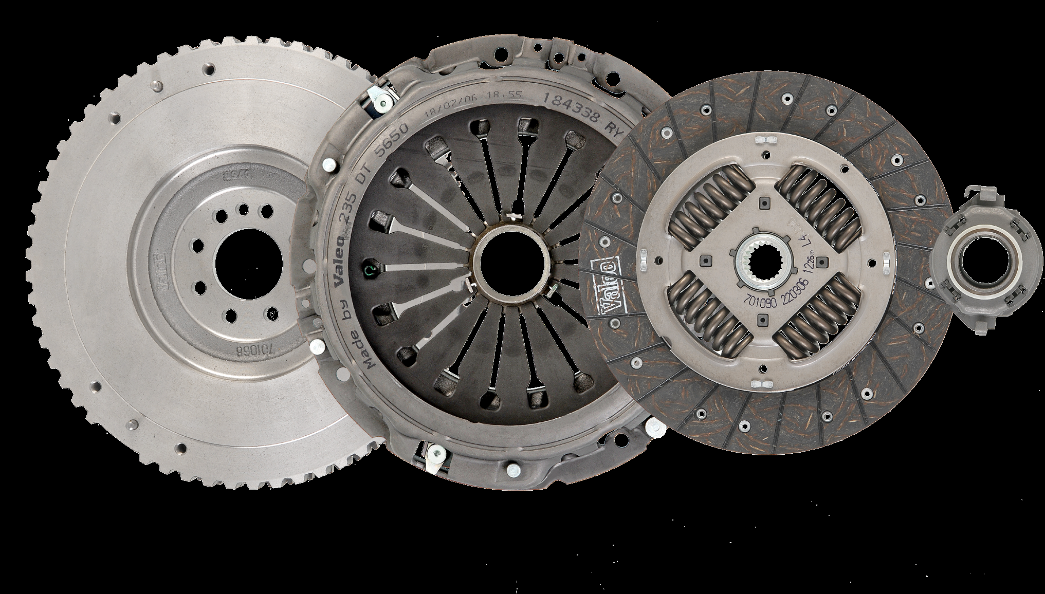
PERFORMANCE
Most KIT4PTM use F510 and F400 facings
(O.E. Trucks Quality)
KIT4PTM
L.T.D.* Disc Technology
(used in KIT4PTM)
is validated in O.E.
since 1994
RECOGNIZED EXPERT
in clutch systems
Since 1923
Valeo
KIT4PTM is a Worldwide success
since 2002
(millions of units equiped)
* Long Travel Damper
Notes:
Why is Valeo a legitimate player for the aftermarket solution in this range?
Legitimacy via technology or beacause leader or because OE adquisitions
Market share OE or growth OE
Innovation OE/IAM
Quality references (awards)
Integration in Valeo Group strategy (smart, green solutions...)
Product regognition IAM or OE

Slide 5
CONVERSION KIT4PTM OFFER
WHY CHOOSE VALEO?
Conversion KIT4PTM is a trustful technology approved by car manufacturers

Slide 6

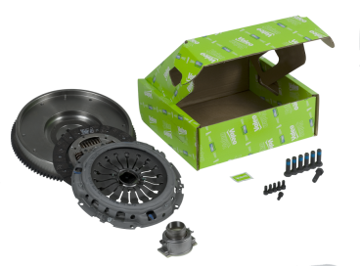

More
competitive than
DMF+Clutch Kit solutions
KIT4PTM
KIT4PTM
Flywheel
Guaranteed
1 Million Kms
GROWING MARKET
115
MILLION
vehicles equipped with DMF in Europe
Eco-friendly
Solution
You never need to replace the Flywheel anymore
(15kg of material
saved for the planet)
ALL-IN-ONE
Quicker choice
Easier to order
No mismatch of components
Easier to fit (bolts included)
Notes:
Why is Valeo a legitimate player for the aftermarket solution in this range?
Legitimacy via technology or beacause leader or because OE adquisitions
Market share OE or growth OE
Innovation OE/IAM
Quality references (awards)
Integration in Valeo Group strategy (smart, green solutions...)
Product regognition IAM or OE

Slide 7

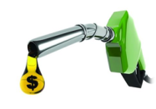
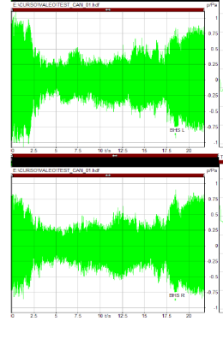

Reliable solution without any
GearBox damages
as inertia is the same
as on DMF+Kit
100% torque transfer
Most of our KIT4PTM
are equipped with High Efficiency Clutch facings
KIT4PTM
Same level of vibrations than a D.M.F.
Higher efficiency allowing to have a
reduced pedal load
NO EXTRA FUEL CONSUMPTION
Certified by IDIADA+ (2018)
D.M.F. Vibrations
Valeo KIT4PTM Vibrations
Notes:
Why is Valeo a legitimate player for the aftermarket solution in this range?
Legitimacy via technology or beacause leader or because OE adquisitions
Market share OE or growth OE
Innovation OE/IAM
Quality references (awards)
Integration in Valeo Group strategy (smart, green solutions...)
Product regognition IAM or OE

Slide 8
CONVERSION KIT4PTM OFFER
GROWTH OPPORTUNITIES
Develop your business in the most simple way: with Valeo Service

Slide 9


z
THE ESSENTIALS
CHOOSE THE RIGHT CARDS
THE ESSENTIALS
CHOOSE THE RIGHT CARDS
VALEO REF | MAIN APPLICATIONS |  | IAM CROSS
835035 | VW | Golf V, Passat | 600001600
835071 | PSA | Berlingo, 206, 307 | 600008400
826317 | VAG | Audi A3, Seat Leon, Golf III | 600000500
835068 | PSA | C4, C5 , 307, 407, 807, 607 | 600013600
835001 | PSA | C5, C8, Jumpy , 406, 607 | 600004800
835159 | VW | Transporter, Multivan | 600016900
835057 | FORD | Transit | 600018600
835008 | PSA | C5, C8, 406 , 607, 807 | 600005000
835007 | PSA | 307 | 601002100
835167 | BMW | 3-Series, X3 | 600023800
835000 | FORD | Transit | 600002300
835071 | PSA | C2, C3, C4, C4 Picasso, C5, Picasso, 206, 207, 307 | 600008400
835089 | MERCEDES | 200/300, E Class | 415020010 + 622215400
835036 | TOYOTA | Avensis, RAV4 | 600001400
835083 | BMW | 3-Series | 600019300
VALEO REF | MAIN APPLICATIONS |  | IAM CROSS
845050 | VW | Golf IV, Polo | 600001300
845153 | VAG | Audi A3, Seat Altea, Skoda Octavia | 2290601009
845048 | RENAULT | Mégane II | 600006800
845019 | FORD | Focus | 600004400
845148 | FIAT | Grande Punto | 600015800
845077 | RENAULT | Clio III, Kangoo | 600006200
845028 | VW | Transporter IV | 600000200
845011 | RENAULT | Laguna II | 600002000
845055 | FORD | Focus II, C-MAX | 600017100
845064 | OPEL | Corsa, Meriva | 600016400
845074 | OPEL | Astra H, Corsa C | 600016600
845006 | VW | Sharan | 600000300
845013 | MERCEDES | Sprinter | 600005600
845059 | FORD | Mondeo III | 600018500
845014 | RENAULT | Espace III | 600004200

